Slide 1
APPLIED DATA SCIENCE WORKSHOP SERIES
4
Applied Machine Learning
When and Why to Use It
Presenter : Terri-Ann Grant
Data Science Graduate Specialist
Contact: terrianngrant@scarletmail.rutgers.edu
WEEK 4
Graduate Data Scientist | Applied Data Science Workshop

Slide 2
Workshop Goals
By the end of this session, participants will be able to:
PR
Prepare data for machine learning
TR
Train a Random Forest regression model
EV
Evaluate model performance using MAE, RMSE, and R²
FI
Interpret traditional feature importance
SH
Use SHAP values to explain global model behaviour
LP
Explain individual predictions using local SHAP analysis
RL
Reflect on model limitations and responsible use

Slide 3
What Is Machine Learning?
Pattern recognition and prediction at scale
Machine learning uses data to identify patterns and make predictions.
EXAMPLES
KEY POINT
→
Predicting broadband access
Machine learning is a tool for pattern recognition and prediction.
→
Detecting fraud
→
Recommending products
→
Forecasting demand

Slide 4
The AI Landscape
How AI, ML, Statistics, and LLMs connect
ARTIFICIAL INTELLIGENCE — machines that reason, plan, and adapt
KEY CONNECTIONS
MACHINE LEARNING — learns patterns from data
AI
Broad field — any machine that mimics human reasoning
DEEP LEARNING — multi-layer neural networks
ML
Subset of AI that learns patterns from labelled data
LARGE LANGUAGE MODELS (LLMs)
Deep Lrng
GPT · Claude · Gemini · Llama — trained on vast text to generate language
Subset of ML using multi-layer neural networks
LLMs
Type of deep learning trained on text (GPT, Claude…)
Statistics
The mathematical foundation underlying all of the above
📐 STATISTICS The mathematical foundation of it all — probability, distributions, inference, and optimization power every layer above.

Slide 5
Machine Learning vs Traditional Analysis
Choosing the right approach for the problem
T
Traditional Analysis
ML
Machine Learning
Focuses on explanation
Focuses on prediction
Often uses statistical inference
Learns patterns from data
IMPORTANT
Both approaches are useful depending on the problem.

Slide 6
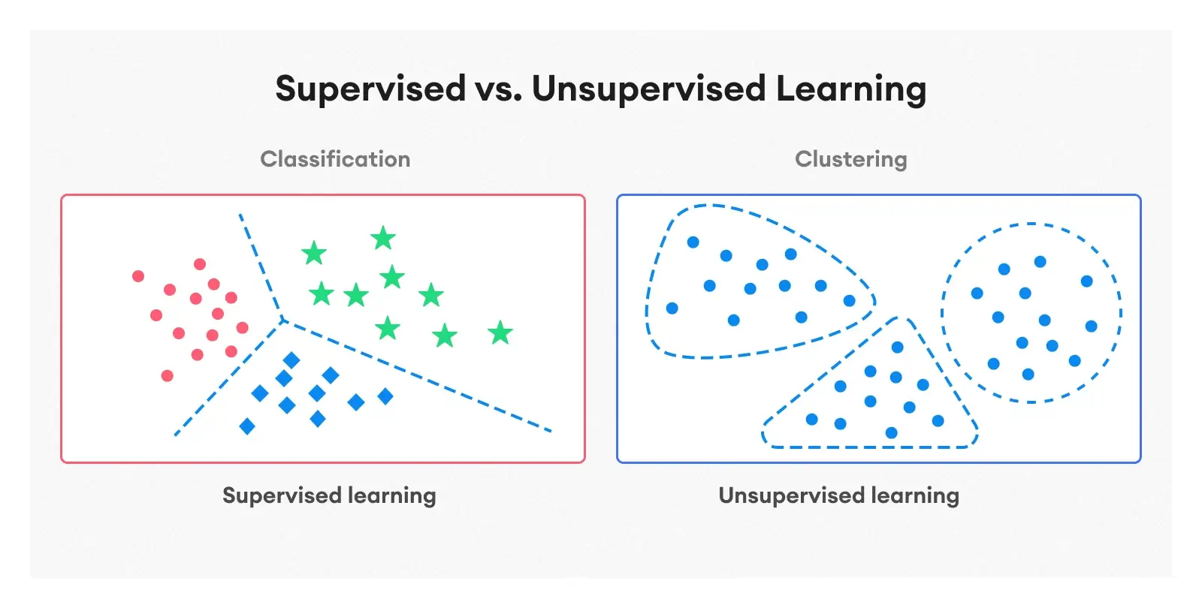
Types of Machine Learning
Two broad families of ML approaches
S
Supervised Learning
U
Unsupervised Learning
Uses labeled outcomes.
Finds hidden patterns.
Examples:
Examples:
R
Regression
Cl
Clustering
C
Classification
Dr
Dimensionality reduction

Slide 7
Real-World Example
Digital equity in New Jersey
CASE STUDY
WHY THIS MATTERS
Can we predict internet access rates using:
Prediction can help identify communities at risk of digital inequity — enabling more targeted investment decisions.
1
Income
2
Education
3
Broadband availability
Dataset: synthetic NJ digital equity data used throughout this workshop series.

Slide 8
Machine Learning Workflow
Six steps from problem definition to results
Define Problem
Prepare Data
1
2
Clarify the question. What are you predicting? For whom?
Clean, transform, and engineer features from raw data.
Split Train/Test
Train Model
3
4
Hold back a portion of data to evaluate the model honestly.
Fit the algorithm to the training data to learn patterns.
Evaluate Model
Interpret Results
5
6
Measure performance on unseen test data using chosen metrics.
Translate numbers into decisions. Consider fairness and context.
KEY POINT
Most time in real projects is spent on steps 1–2, not 3–4.

Slide 9
Introducing SHAP Values
From ‘what predicted’ to ‘why it predicted’
WHAT SHAP DOES
KEY CONCEPT
1
Shows which features pushed a prediction higher or lower
Traditional feature importance tells you which variables matter overall.
SHAP tells you why the model made each individual prediction.
2
Provides both global (overall dataset) and local (one prediction) explanations
3
Works especially well with tree-based models like Random Forest
SHAP = SHapley Additive exPlanations
A game-theory approach that fairly attributes each prediction to each input feature.

Slide 10
Reading SHAP Outputs
Three chart types you will use in the workshop
BSW
BAR
WF
Beeswarm / Summary Plot
Bar Plot
Waterfall / Local Plot
Each dot = one observation. Position on x-axis shows impact. Color shows whether feature value is high or low. Top features matter most.
Mean absolute SHAP value per feature. A clean global ranking of variable influence — easier to read than the beeswarm at a glance.
Shows how the model moves from a baseline prediction to the final value for one specific observation. Best for explaining one case.
Use for: global overview
Use for: quick global ranking
Use for: explaining one prediction
In the workshop, you will generate all three of these for the internet access rate model.

Slide 11
Hands-On Activities
What participants will do in the workshop notebook
1
Prepare and clean the dataset
Inspect, flag placeholders, impute/drop missing values.
2
Split data and train a Random Forest
80/20 train-test split, then fit the Random Forest regressor.
3
Evaluate model performance
Calculate MAE, RMSE, and R² on the held-out test set.
4
Interpret traditional feature importance
Rank variables by their average contribution across all trees.
5
Generate SHAP summary and bar plots
See which features matter globally and in which direction.
6
Explain one prediction with SHAP
Use a waterfall plot to explain a single community’s prediction.
7
Reflect on limitations and fairness
Discuss bias, overfitting, and responsible use of model outputs.

Slide 12
Model Evaluation
Choosing and interpreting the right metrics
MAE
RMSE
R²
Mean Absolute Error
Root Mean Squared Error
R-squared
Like MAE, but penalises large errors more heavily. Useful when big mistakes are especially costly.
Proportion of outcome variance explained by the model. Ranges from 0 to 1 (higher = better fit).
Average absolute difference between predicted and actual values. Easy to interpret in original units.
Note: Accuracy, Precision, Recall, and F1 Score are classification metrics — used when predicting categories, not numbers. This workshop is a regression task, so we use MAE, RMSE, and R².
KEY POINT
High performance does not always mean the model is useful or fair.

Slide 13
Model Limitations
What to watch for before acting on predictions
B
Bias in Data
If training data reflects past inequities, the model will too.
O
Overfitting
A model that memorises training data performs poorly on new data.
M
Missing Variables
Unmeasured factors can make predictions inaccurate or misleading.
G
Poor Generalisation
A model trained on one region or time period may not transfer.
Key Idea: Models should support decision-making, not replace it.

Slide 14
KEY TAKEAWAYS
Session 4 — Applied Machine Learning
1
Machine learning supports prediction — interpretation is what makes it useful
2
SHAP values reveal why a model predicts, not just what it predicts
3
Regression and classification tasks require different evaluation metrics
4
Models should support decisions, not replace human judgment and context

